Slide 1
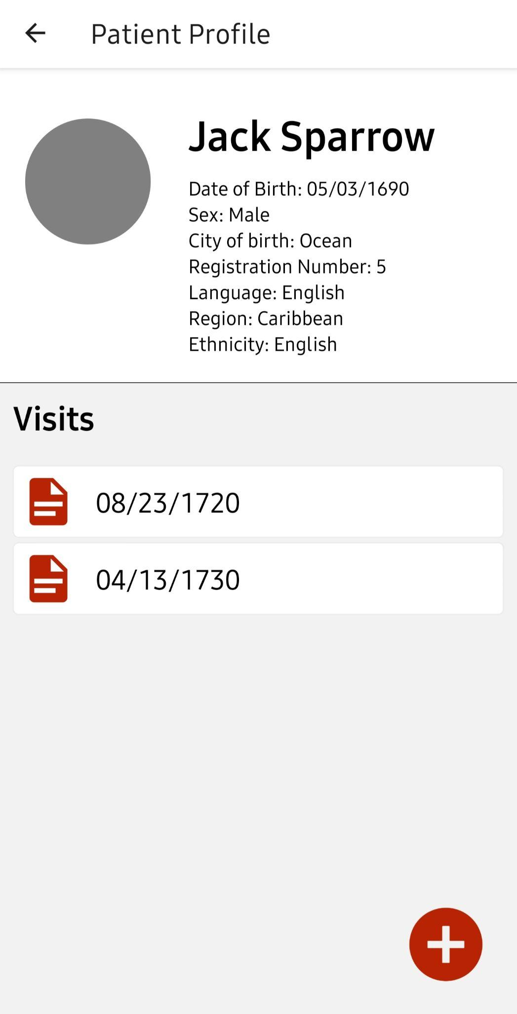

OPUS
Offline Patient Uploading Software
Adam Brink, Owen Pruim, Josiah Ryan, Fitsum Maru
Notes:
Good morning everyone, and welcome to our app demonstration.
Our application is called offline patient uploading software, or OPUS for short. OPUS was produced at the request of Earth Mission Asia, an organization that trains and supports doctors working in the remote regions of Myanmar.

Slide 2
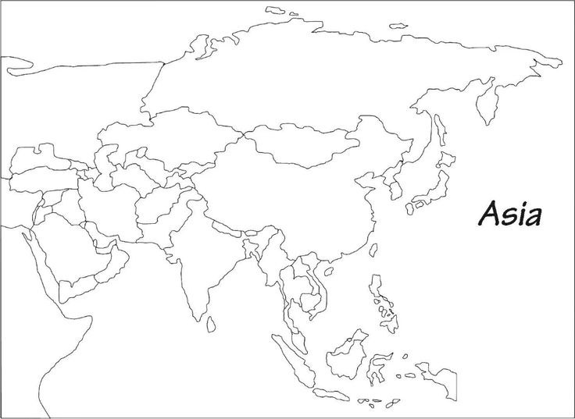
Notes:
Map guessing game: Can anyone tell me where Myanmar is? Any Guesses?

Slide 3
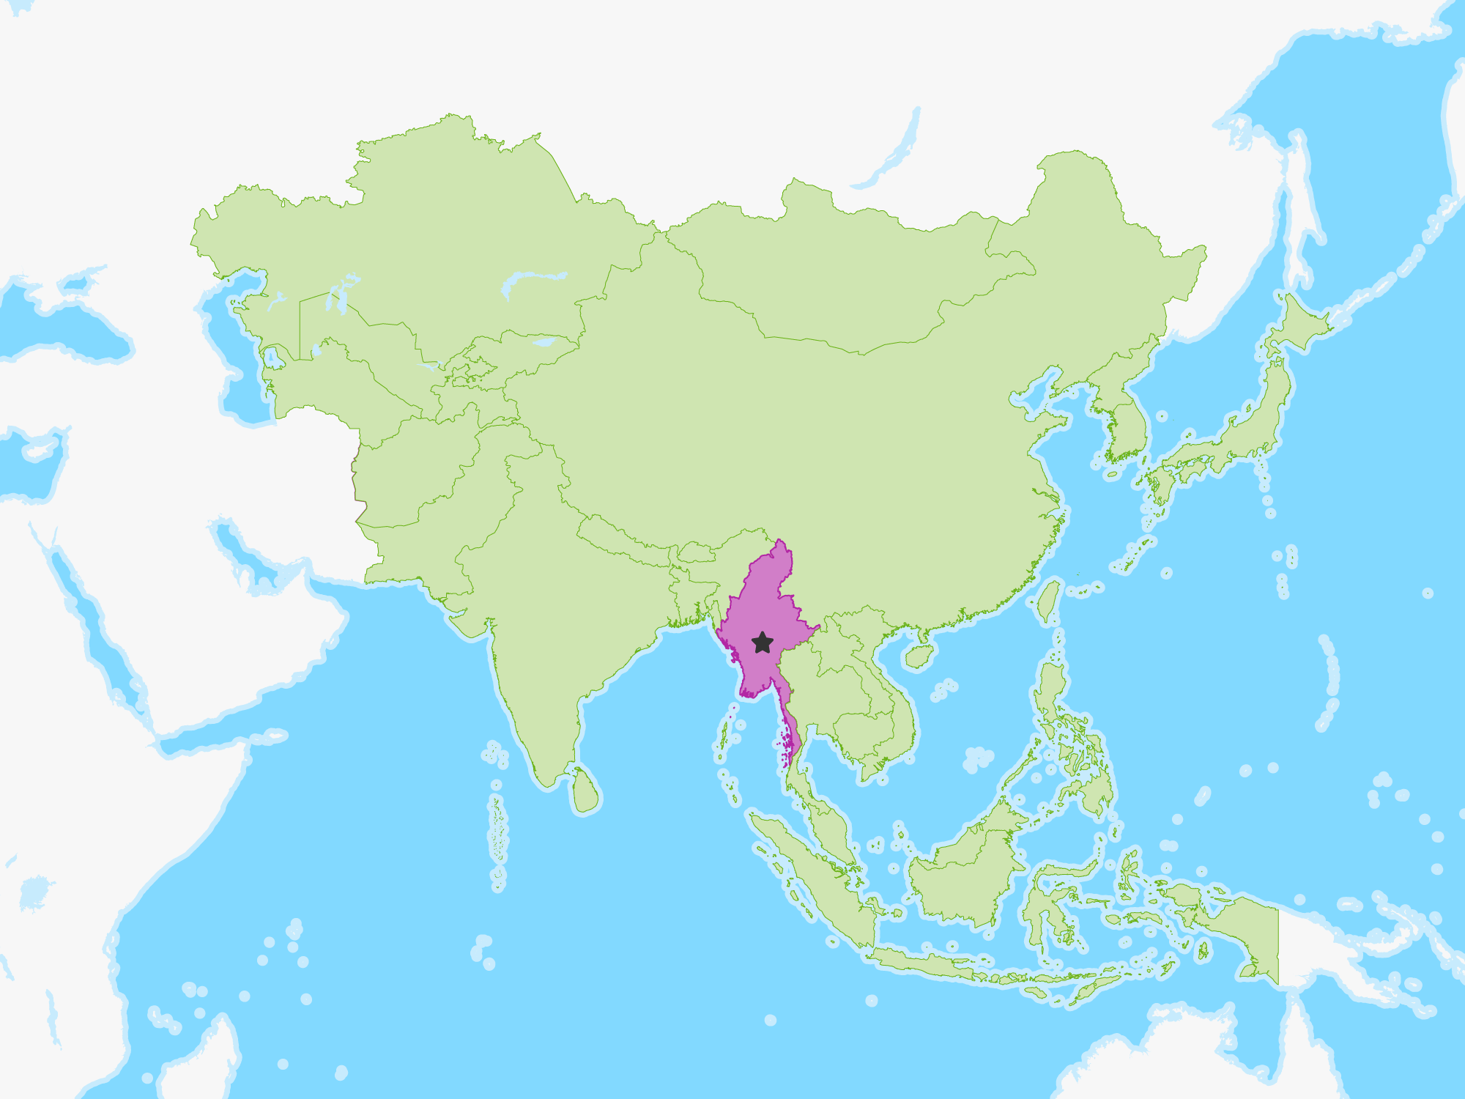
Notes:
Myanmar is South of China, and East of India, bordering Thailand
Myanmar has complicated political, ethnical, and economic issues that have led to certain ethnic groups being marginalized. Specifically, the Karen ethnic group who live along the border between Myanmar and Thailand, have been marginalized and as a result do not have the money or resources to have adequate medical care in many regions.

Slide 4
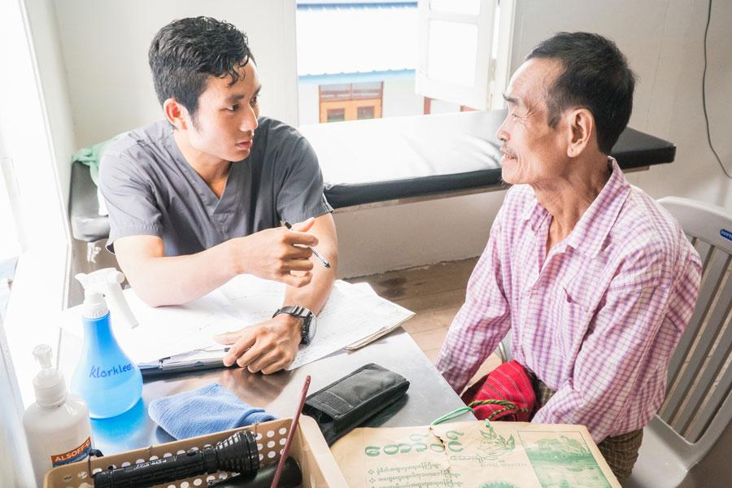
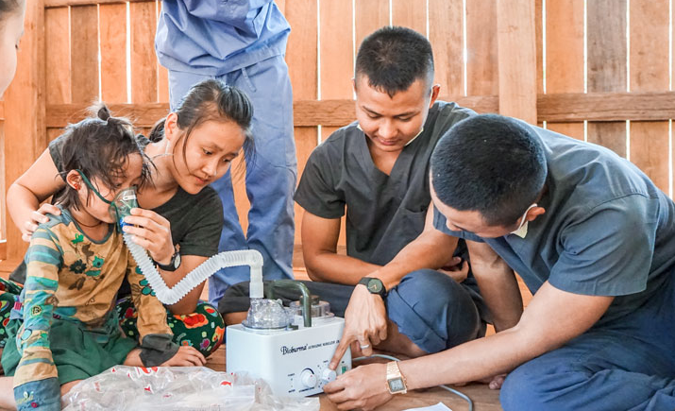

-30+ Karen Students
-12,000+ patients treated
Notes:
This is where Earth Mission Asia comes in. Earth Mission Asia is an organization that trains Karen students, who generally have a much harder time getting into higher education due to their often lacking schooling and racism in the country against the Karen in general. These Karen students are trained as doctors or engineers, and encouraged to work in or around Earth Mission clinics in this border region.
In 2020, over 30 Karen students worked with Earth Mission Asia’s medical and Engineering programs to care for over 12 thousand patients.
A part of the administrative side of this programs involves recording a storing records of patients and their visits.

Slide 5
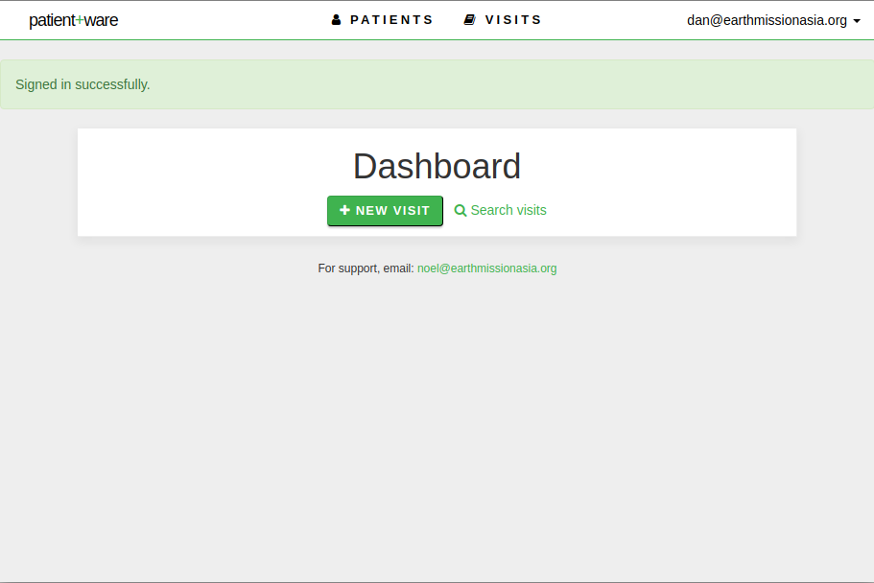
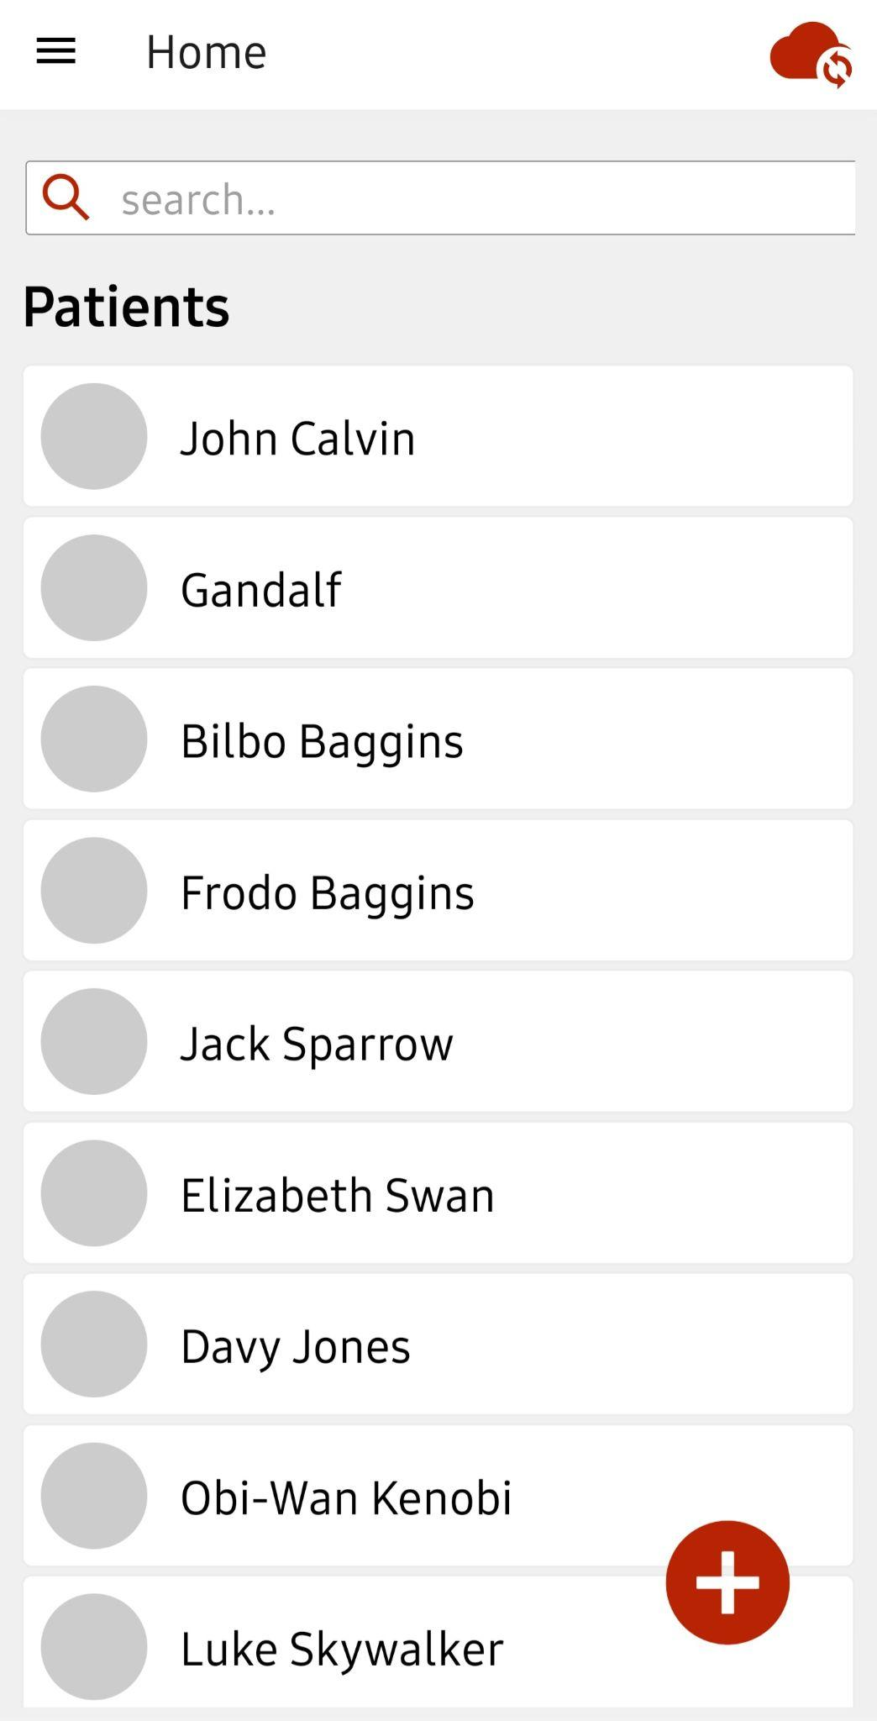
Notes:
EMA has an online patient uploading software website that allows them to record patient information called patient ware. However, this software is only accessible when connected to cellular service.
This is increasingly a problem as EMA expands and establishes clinics further away from cities. This is where our app is needed. Our app, OPUS, has the same functionality as patient-ware, but with the additional feature of being useable offline, and thus useable in these remote regions.

Slide 6

Demo
Notes:
-Login right away - first wrong password
-Sync patients
-View a profile
-View a visit
-Add patient
-Add a visit to created patient
-Edit then delete created visit
-Search
-About Page
-Help Page
During our user tests, many users had some suggestions for some minor formatting adjustments such as spacing, color, or size of buttons. However, the one thing that almost every single user mentioned was a desire for a more user-friendly date entry. This was something we hadn’t really considered ourselves, but due to all of the user comments, we decided to implement it.
Overall, most users were able to perform every task with no help and commented that our app was very simple, straightforward, and easy to use.
System overview.
-patients are in a list
-each patient has a list of visits

Slide 7
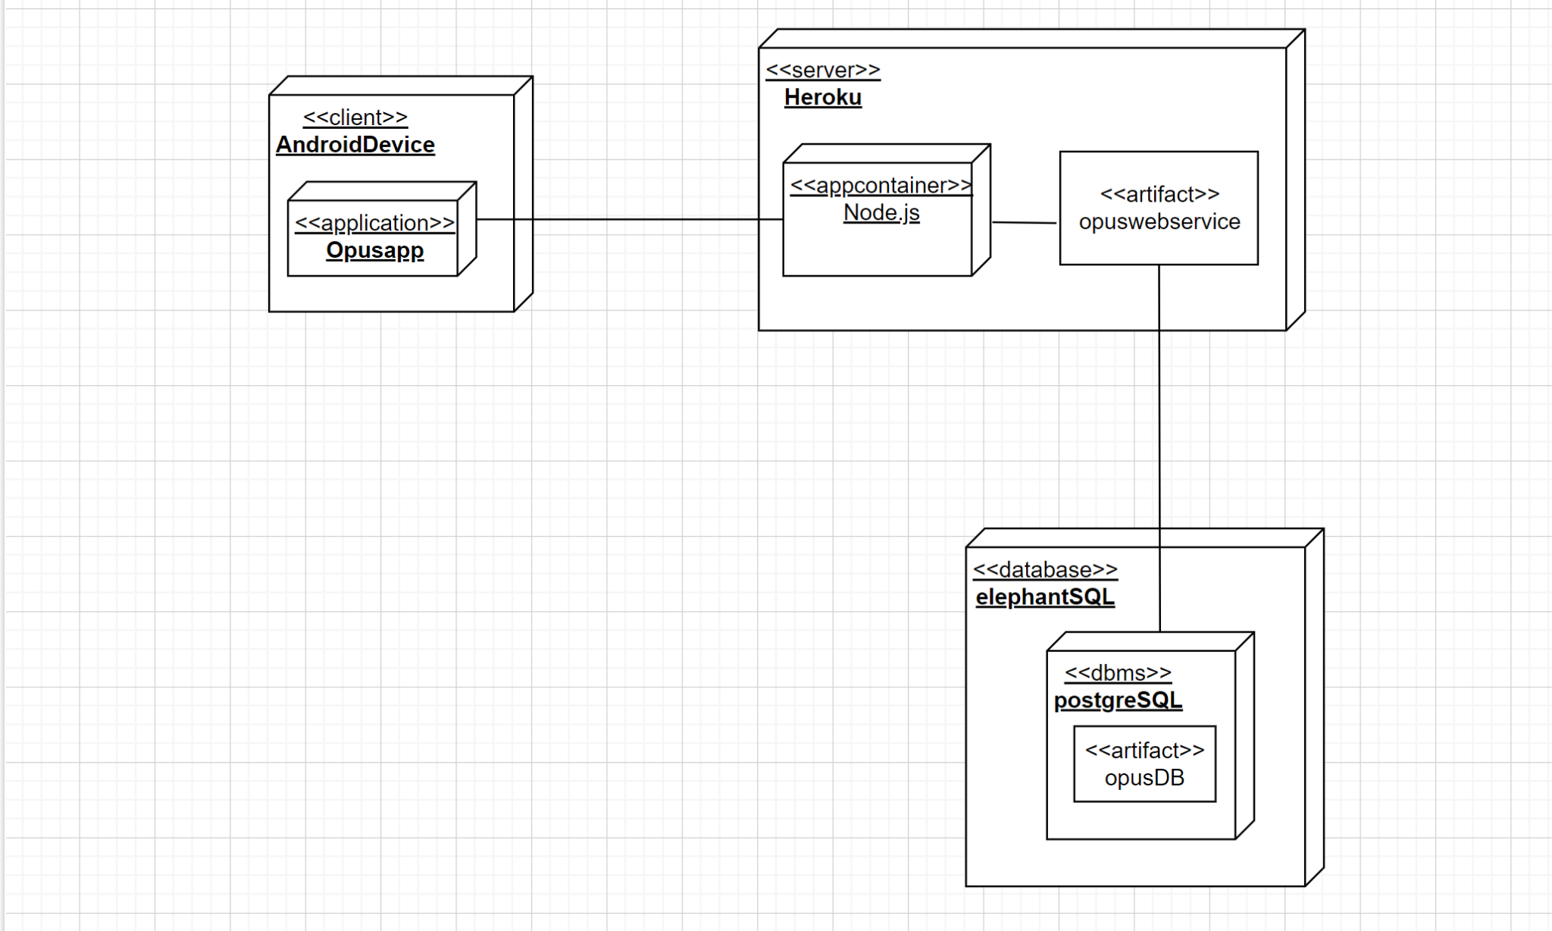
Deployment Diagram
Notes:
Brief explanation of deployment diagram. Start with database (what service we are using), to the server, to the app. Explain what the database is being used for
Explain restful-ness data protection from design of server-client
Kieth: dont have android written

Slide 8
Strengths and Future Work
Strengths
Simple Interface
Meets EMA’s Requirements
Potential To Help People In Need
Future Work
Add languages
Server Data Protection/Encryption
Edit/Delete Patient
Notes:
Functionality
Capable of performing most important tasks offline (adding patients, adding/editing visit information)
Capable of interacting with a data server (uploads and downloads patient data)
Future Prospects
Could be used by EMA in Myanmar if further developed
Implications
Could improve healthcare in Myanmar jungles

Slide 9
Questions?

Slide 10
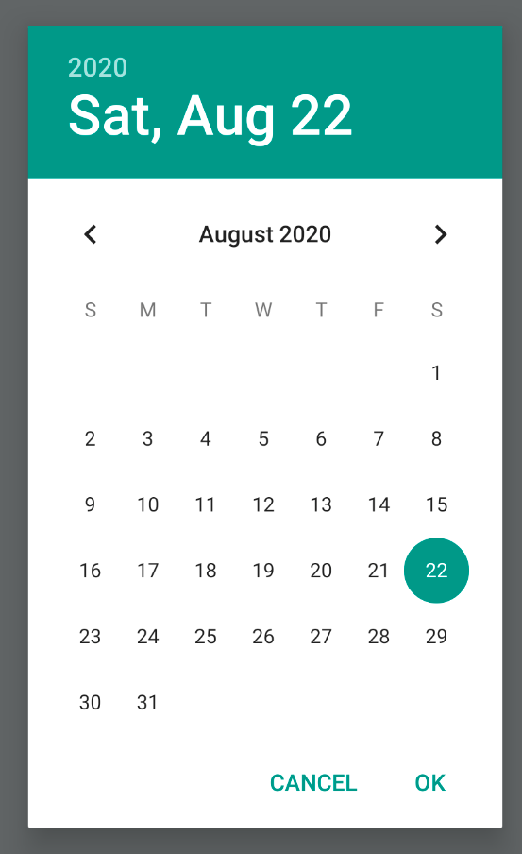
Usability Testing
Minor formatting adjustments
Request for more user-friendly date entry
Overall, users found the app very easy and
straightforward to use
Notes:
During our user tests, many users had some suggestions for some minor formatting adjustments such as spacing, color, or size of buttons. However, the one thing that almost every single user mentioned was a desire for a more user-friendly date entry. This was something we hadn’t really considered ourselves, but due to all of the user comments, we decided to implement it.
Overall, most users were able to perform every task with no help and commented that our app was very simple, straightforward, and easy to use.

